Slide 1




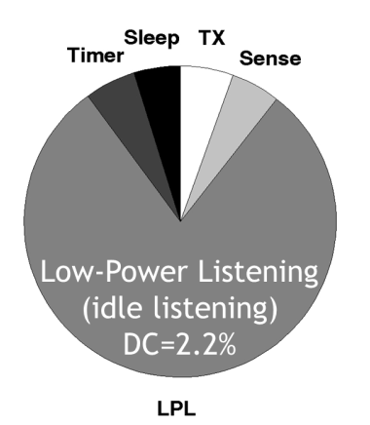
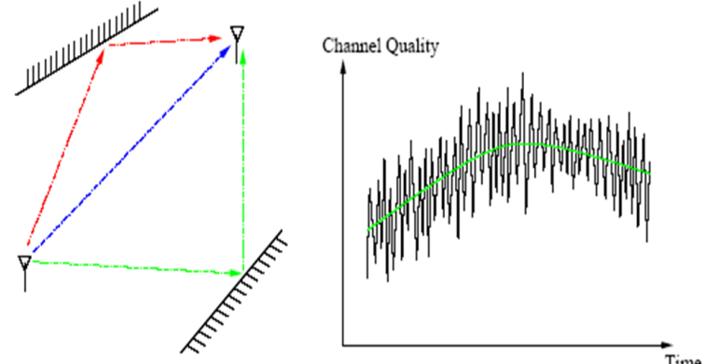
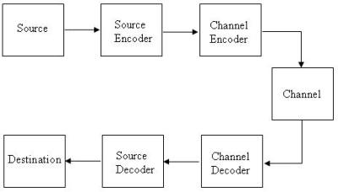
EECS 473
Advanced Embedded Systems
Lecture 13
Start on Wireless

Slide 2
Feedback and Upcoming
Quick survey
  Who has gotten their PCB out?
PCBs
  All are to be out by 10/31.
  Strongly suggest you get them reviewed
MS2
  Report due on Tuesday 11/7
  Check-offs due by Wednesday 11/8 @6pm
  MS2 meetings start on Thursday 11/9

Slide 3
Team status updates for Thursday
Largest roadblock
Thing you are most pleased with wrt your project.

Slide 4
Wireless communications
Introduction to embedded wireless
Next 2.5 lectures are going to cover wireless communication
  Both theory and practice.
If you’ve had a communication systems class, there will be some overlap
  And we will be focusing on digital where we can
    Though that’s still a lot of analog.

Slide 5
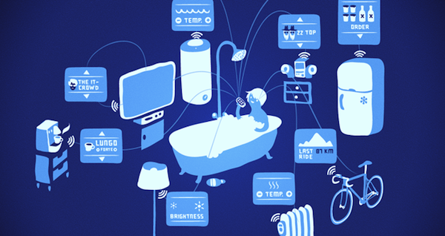
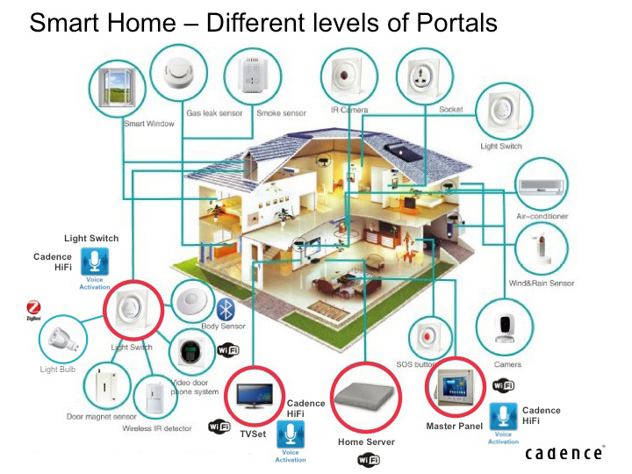
Wireless and embedded?
Introduction to embedded wireless
As should be obvious, modern embedded systems are tied closely to wireless communication.
  Think about your projects.
Applications include the home…

Slide 6
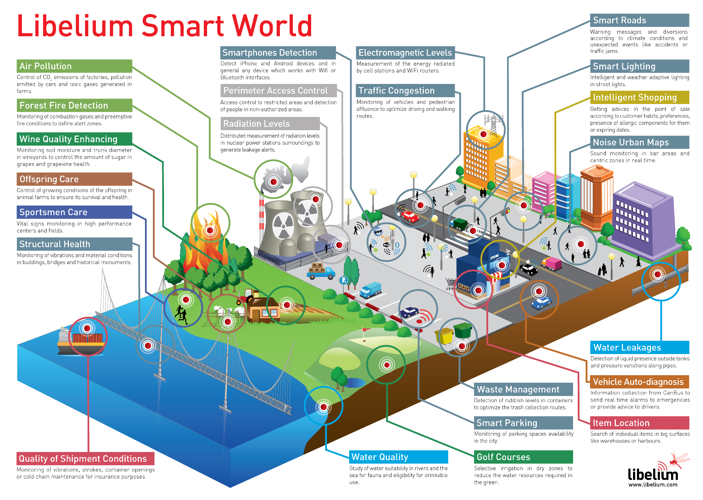
But certainly reach much farther
Introduction to embedded wireless

Slide 7
Lots of peer-to-peer wireless protocols
Introduction to embedded wireless
Wi-Fi high-speed data with ranges of about 20-40 meters. Fairly high power consumption. If you want to get on the Internet, this is usually the way to go.
Bluetooth is a global 2.4 GHz personal area network for short-range wireless communication. Device-to-device file transfers, wireless speakers, and wireless headsets are common users. Range can get quite long with 5.0 (~200 meters)
  BLE is a version of Bluetooth designed for lower-powered devices that use less data. To conserve power, BLE remains in sleep mode except when a connection is initiated. This makes it ideal for wearable fitness trackers and health monitors.
ZigBee is (mostly) a 2.4 GHz mesh local area network (LAN) protocol built on 802.15.4. It was designed for building automation and still sees a lot of use there.
RFID Allows passive (unpowered) devices to communicate.
  NFC a protocol used for very close communication. If you wave your phone to pay for groceries, you’re likely using NFC. Closely related to RFID.
LoRaWAN is a long-range (1-15km), low-power, low-data rate (~1-50kbits/sec) protocol.
Z-Wave is a priority protocol design for home automation. <30 meter range. Has some nice dev kits. Very low power.
SigFox, Ingenu, Weightless-(N, P, W), ANT, DigiMesh, MiWi, EnOcean, Dash7, WirelessHART. Probably a lot more.
Mostly from https://iotdesignpro.com/articles/different-types-of-wireless-communication-protocols-for-iot
Notes:
http://www.link-labs.com/complete-list-iot-network-protocols/

Slide 8
Cellular
Rather than peer-to-peer, we can go through cell phone towers or even satellites.
  If you want to go *far* the only other real option is shortwave radio (limited to about 300 baud)
This used to be very expensive, but for small amounts of data, it may be viable.
  For example, TruPhone will give you 125MB to use for 5 years for $19.00.
  There are some variations out there (e.g. Cat-M1, G4 )
    Tradeoffs aren’t hugely clear.

Slide 9
Two and half Lectures
Introduction to embedded wireless
Start at the high-level
  Overview by example: Zigbee/802.15.4
    OSI model
      MAC layer
Go to low-level
  Source & channel encoding
  Multi-path issues
  Modulation
  Range

Slide 10
Outcomes: Things you should be able to answer after these lectures.
Introduction to embedded wireless
Why might I choose the (lower bandwidth) 915MHz frequency over the 2.4GHz?
  Related: Why are those the only bands I can pick?
  Related: Why can shortwave radio in China reach the US? Why are their so many Cubs fans? (actually related)
How do I compute “open space” radio distances?
  How do I convert “open space” radio distances in a specification to indoor distances?
How do I deal with a dropped packet?
How much data can I hope to move over this channel?

Slide 11
Zigbee
Zigbee--basics
ZigBee is an IEEE 802.15.4-based protocol
  used to create personal area networks with small, low-power digital radios.
Simpler and less expensive than Bluetooth or Wi-Fi.
Used for wireless light switches, electrical meters with in-home-displays, etc.
Transmission distances to 10–100 meters line-of-sight
  Zigbee Pro can hit a mile
Secure networking
  (ZigBee networks are secured by 128 bit symmetric encryption keys.)
ZigBee has a defined rate of 250 kbit/s, best suited for intermittent data transmissions from a sensor or input device.

Slide 12
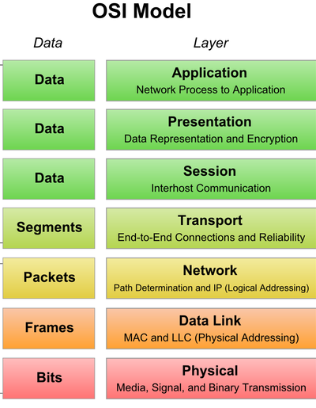
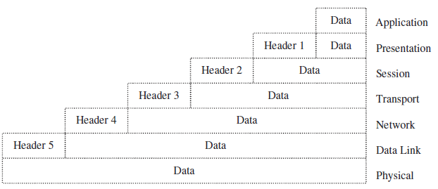
At the end of the day all wireless is just sending bits over the air.
Zigbee—basics
Two issues:
  How you send those bits (physical layer)
  How you use those bits (everything else)
We’ll discuss both

Slide 13
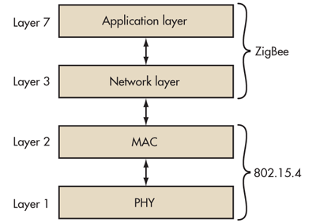
To minimize overhead, Zigbee skips some layers
Zigbee—basics
Notes:
Last figure from From: ZigBee Wireless Networks and Transceivers by Shahin Farahani

Slide 14
Zigbee—basics
From: ZigBee Wireless Networks and Transceivers by Shahin Farahani
Notes:
The book.

Slide 15
OSI basic idea
Zigbee—basics
Each layer adds some header information to address a specific problem.
  What task on the target is this message related to?
    A given sensing unit might have a lot of sensors for example.
  What if we have a longer message
  than one frame?
    What if one of those
    frames gets dropped?
Example on next pages:
  Data link to Physical.

Slide 16
MAC (data link) layer (802.15.4)
Zigbee—basics
Frame control basics:
  What type of frame?
  Security enabled?
  Need to Ack?
Frame control—frame size
  Sender/receiver on same PAN?
  Address size for source and destination (16 or 64 bit)
  Which standard? (Frame version)

Slide 17
MAC layer (802.15.4)
Zigbee—basics
Sequence number
  Used to reassemble packets that came out of order.
  Or detect a resent packet
PAN IDs and addresses are just what you’d think.
Auxiliary Security header specifies encryption schemes
FCS (Frame check sequence)
  CRC for detecting errors.
Notes:
P69-71

Slide 18
Physical layer
Zigbee—PHY layer
There is a lot about the physical layer to understand. We’ll do some on Tuesday.

Slide 19
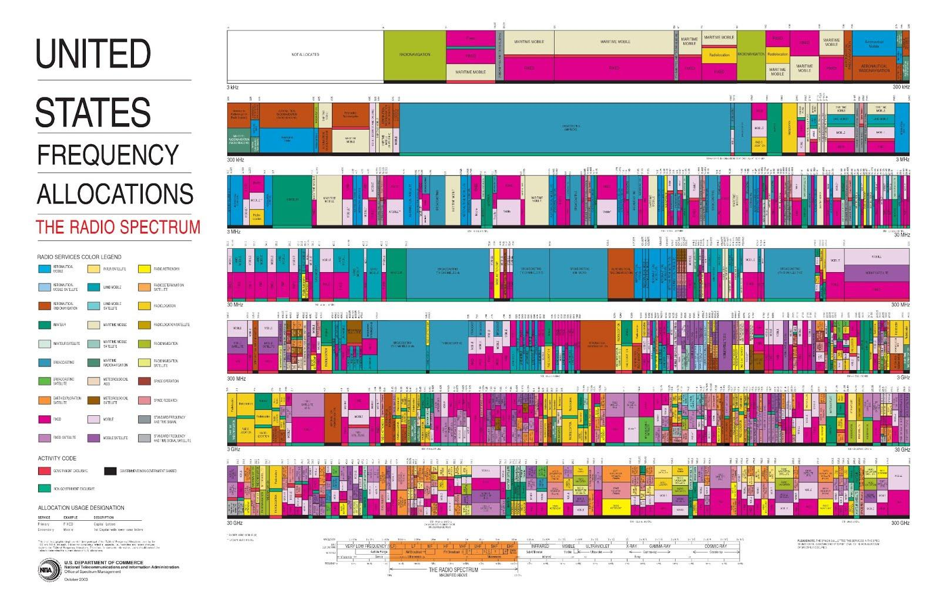
PHY layer
Image taken from: en.wikipedia.org/wiki/File:United_States_Frequency_Allocations_Chart_2003_-_The_Radio_Spectrum.jpg

Slide 20
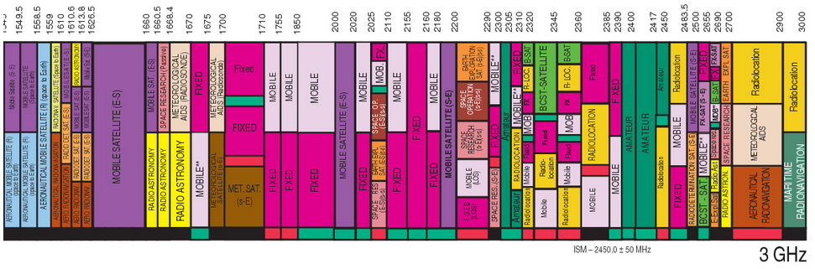
United States Partial Frequency Spectrum
PHY layer
Image taken from: en.wikipedia.org/wiki/File:United_States_Frequency_Allocations_Chart_2003_-_The_Radio_Spectrum.jpg

Slide 21
Message, Medium, and Power & noise
PHY layer
Message
  Source encoding, Channel encoding, Modulation, and
  Protocol and packets
Medium
  Shannon’s limit, Nyquist sampling, Path loss, Multi-channel, loss models, Slow and fast fading.
Signal power & noise power
  Receive and send power, Antennas, Expected noise floors.
Putting it together
  Modulation (again), MIMO

Slide 22
So starting with the message
PHY layer
We are trying to send data from one point to the next over some channel.
  What should we do to get that message ready to go?
  The basic steps are
    Convert it to binary (if needed)
    Compress as much as we can
      to make the message as small as we can
    Add error correction
      To reduce errors
      But, unexpectedly, also to speed up communication over the channel.
  The receiver will need to undo all that work.

Slide 23
Communicating a Message (1/3)
PHY layer
Source
  The message we want to send.
  We’ll assume it’s in binary already.
Source encoding
  Compression; remove redundancies.
  Could be lossy (e.g. jpeg)
  Called source encoding because depends on source type (think jpeg vs mp3)
Source
Encoder
Channel
Encoder
Modulator
Channel
Source
Decoder
Channel
Decoder
De-
modulator

Slide 24
Communicating a Message (2/3)
PHY layer
Channel encoder
  Add error correction.
  Called channel encoder, because error correction choices depend on channel.
Modulator
  Convert to analog.
    Figure out how to move to carrier frequency.
    Lots of options including:
      Frequency modulation
      Amplitude modulation
      Phase modulation
Source
Encoder
Channel
Encoder
Modulator
Channel
Source
Decoder
Channel
Decoder
De-
modulator
Note: some sources consider
modulation to be part of the channel
encoder.
Notes:
https://www.nhk.or.jp/strl/publica/bt/en/le0014.pdf

Slide 25
Communicating a Message (3/3)
PHY layer
Channel
  The medium over which our encoded message is sent.
  For the type of wireless communication we are doing, we are talking about using radio frequencies (RF) to connect two points not connected by a conductor.
  Lossy.
Source
Encoder
Channel
Encoder
Modulator
Channel
Source
Decoder
Channel
Decoder
De-
modulator
Then the receiver undoes all that (demodulation and the two decoders)
  Often more work than sending!

Slide 26
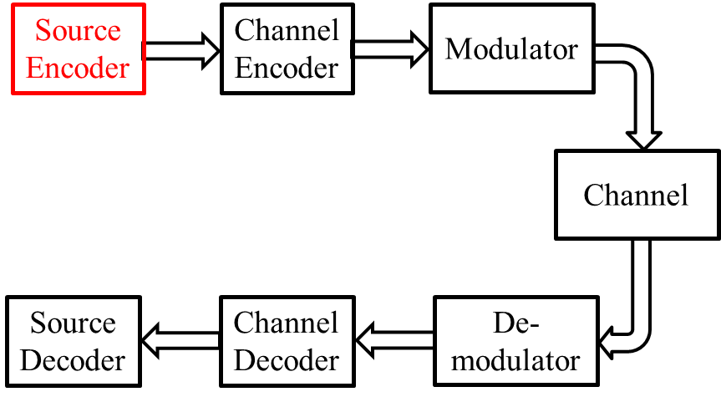
Source encoding
Pretty much traditional CS techniques for compression
  Very much dependent on nature of source
    We use different techniques for different things.
    Huffman encoding is the basic solution
Goal here is to remove redundancy to make the message as small (in bits) as possible.
  Can accept loss in some cases (images, streaming audio, etc.)
For more information: http://en.wikipedia.org/wiki/Data_compression,
http://www.ccs.neu.edu/home/jnl22/oldsite/cshonor/jeff.html

Slide 27
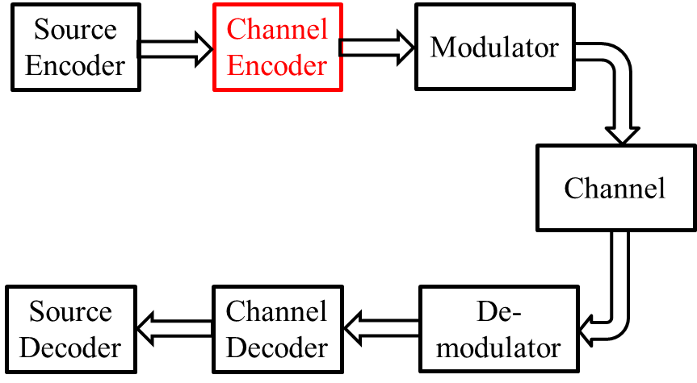
Channel encoding (1/3)
Error correction and detection
  We are adding bits back into the message (after compression) to reduce errors that occur in the channel.
  The number of bits added and how we add them depends on characteristics of the channel.
Idea:
  Extra bits add redundancy.
  If a bit (or bits) go bad, we can either repair them or at least detect them.
  If detect an error, we can ask for a resend.

Slide 28
Channel encoding (2/3)
Block codes
  In this case we are working with fixed block sizes.
  We take a group of N bits, add X bits to the group.
  Some schemes promise correction of up to Y bits of error (including added bits)
  Others detect Z bits of error.
Specific coding schemes
  Add one bit to each block (parity)
    Can detect any one bit error.
  Take N bits, add ~log₂(N) bits (for large N)
    Can correct any one bit error.
  Both of the above can be done using Hamming codes.
    Also Reed-Solomon codes and others.
See http://en.wikipedia.org/wiki/Block_code for more details.

Slide 29
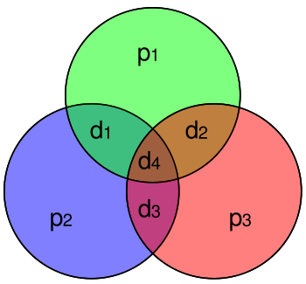
Example block code:
Hamming(7,4)
Figure from Wikipedia
Hamming(7,4)-code.
  Take 4 data elements (d₁ to d₄)
  Add 3 parity bits (p₁ to p₃)
    p₁=P(d₁, d₂, d₄)
    p₂=P(d₁, d₃, d₄)
    p₃=P(d₂, d₃, d₄)
  If any one bit goes bad (p or d) can figure out which one.
    Just check which parity bits are wrong. That will tell you which bit went wrong.
    If more than one went wrong, scheme fails.
Much more efficient on larger blocks.
  E.g. (136,128) code exists.
Example:
  Say
    d[1:4]=4’b0011
  Then:
    p₁=P(0,0,1)=1
    p₂=P(0,1,1)=0
    p₃=P(0,1,1)=0
  If d₂ goes bad (is 1)
    Then received p₁ and p₃ are wrong.
    Only d₃ covered by both (and only both)
      So d₃ is the one that flipped.

Slide 30
In-Class Example
Hamming(7,4)-code.
  Take 4 data elements (d₁ to d₄)
  Add 3 parity bits (p₁ to p₃)
    p₁=P(d₁, d₂, d₄)
    p₂=P(d₁, d₃, d₄)
    p₃=P(d₂, d₃, d₄)
If we get: 1000101
  What was the data?
If we get: 1111111
  What was the data?
If we get: 0100100
  What was the data?

Slide 31
Channel encoding (3/3)
Turbo codes are a type of convolution code that can provide near-ideal error correction
  That’s different than perfect, just nearly as good as possible.
  Approaches Shannon’s limit, which we’ll cover shortly.
Low-density parity-check (LDPC) codes are block codes with similar properties.
Convolution codes
  Work on a sliding window rather than a fixed block.
  Often send one or even two parity bits per data bit.
Can be good for finding close solutions even if wrong.
  Viterbi codes are a very common type of
See http://en.wikipedia.org/wiki/Convolutional_code for more details.

Slide 32
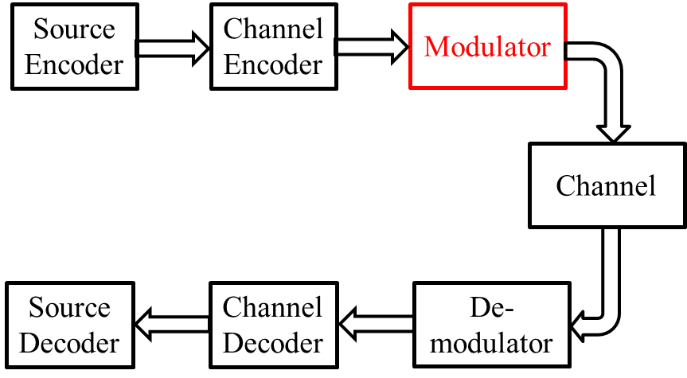
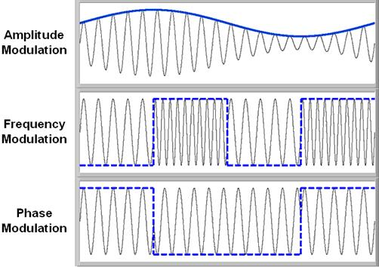
Modulation
We take an input signal and move it to a carrier frequency (f_{c}) in a number of way.
  We can vary the amplitude of the signal
  We can vary the frequency of the signal.
  We can vary the phase of the signal.
Figure from http://www.ni.com/white-paper/4805/en/

Slide 33
Terms: “keying”
Keying is a family of modulations where we allow only a predetermined set of values.
  Here, frequency and phase only have two values, so those two examples are “keying”
    Note phase and frequency could be continuous rather than discrete.

Slide 34
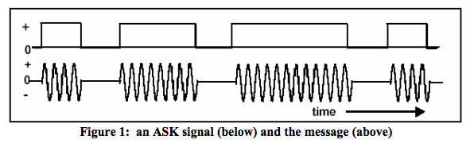
Example:
Amplitude-Shift Keying (ASK)
Changes amplitude of the transmitted signal based on the data being sent
Assigns specific amplitudes for 1's and 0's
On-off Keying (OOK) is a simple form of ASK
Figure from http://www.ele.uri.edu/Courses/ele436/labs/ASKnFSK.pdf

Slide 35
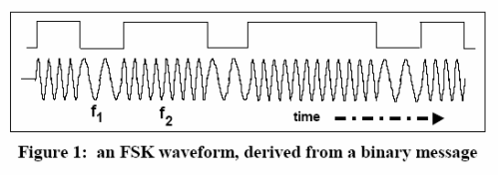
Example:
Frequency Shift Keying (FSK)
Changes frequency of the transmitted signal based on the data being sent
Assigns specific frequencies for 1's and 0's
Figure from http://www.ele.uri.edu/Courses/ele436/labs/ASKnFSK.pdf

Slide 36
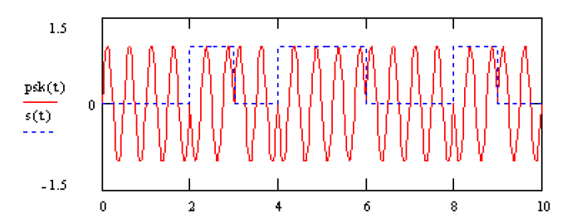
Example:
Phase Shift Keying (PSK)
Changes phase of the transmitted signal based on the data being sent
Send a 0 with 0° phase, 1 with 180° phase
This case called Binary Phase Shift Keying (BPSK)
Figure from http://people.seas.harvard.edu/~jones/cscie129/papers/modulation_1.pdf

Slide 37
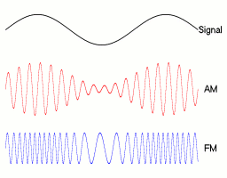
And we can have modulation of a continuous signal
Figure from http://en.wikipedia.org/wiki/Modulation

Slide 38
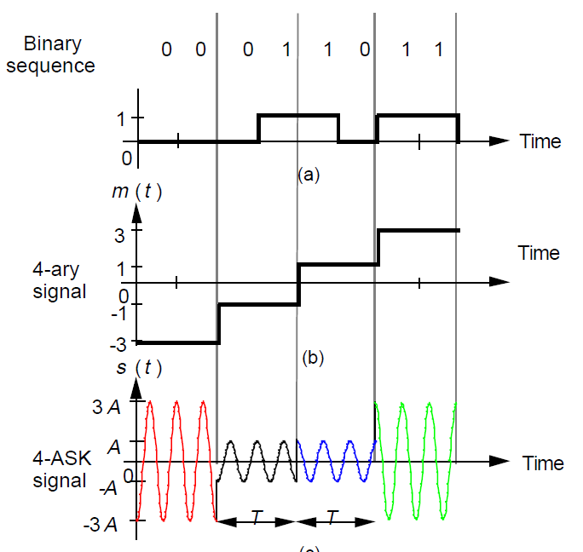
Back to Keying—M-ary
It’s possible to do more than binary keying.
  Could use “M-ary” symbols
    Basically have an alphabet of M symbols.
  For ASK this would involve 4 levels of amplitude.
    Though generally it uses 2 amplitudes, but has “negative valued” amplitudes.
Figure from http://engineering.mq.edu.au/~cl/files_pdf/elec321/lect_mask.pdf

Slide 39
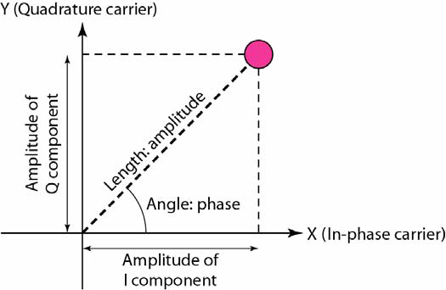
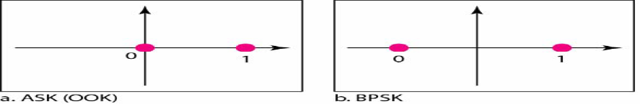
Key “constellations”
Draw the 4-ASK constellation.
New figures from http://www.eecs.yorku.ca/course_archive/2010-11/F/3213/CSE3213_07_ShiftKeying_F2010.pdf

Slide 40
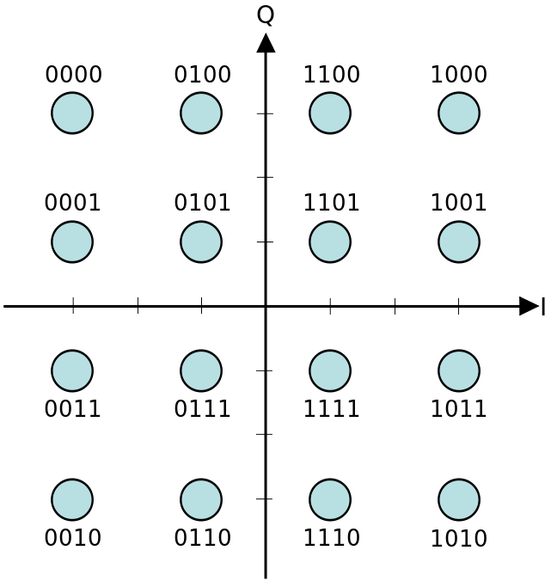
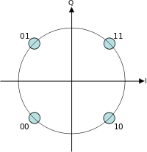
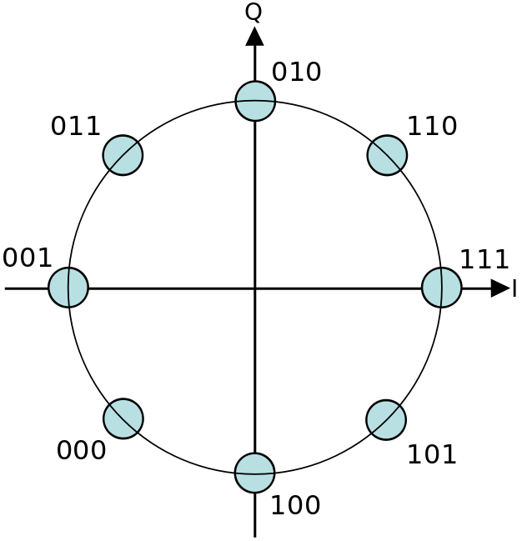
Some constellations
16-QAM
(Quadrature amplitude)
4-PSK
QPSK
4-QAM
(lots of names)
8-PSK
QPSK=quadriphase PSK. Really.
Figures from Wikipedia

Slide 41
QAM
Can be thought of as varying phase and amplitude for each symbol.
  Can also be thought of as mixing two signals 90 degrees out of phase.
    I and Q.
16-QAM
(Quadrature amplitude)

Slide 42
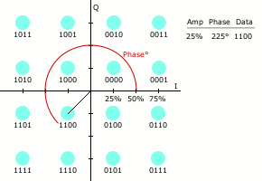
Animation from Wikipedia

Slide 43
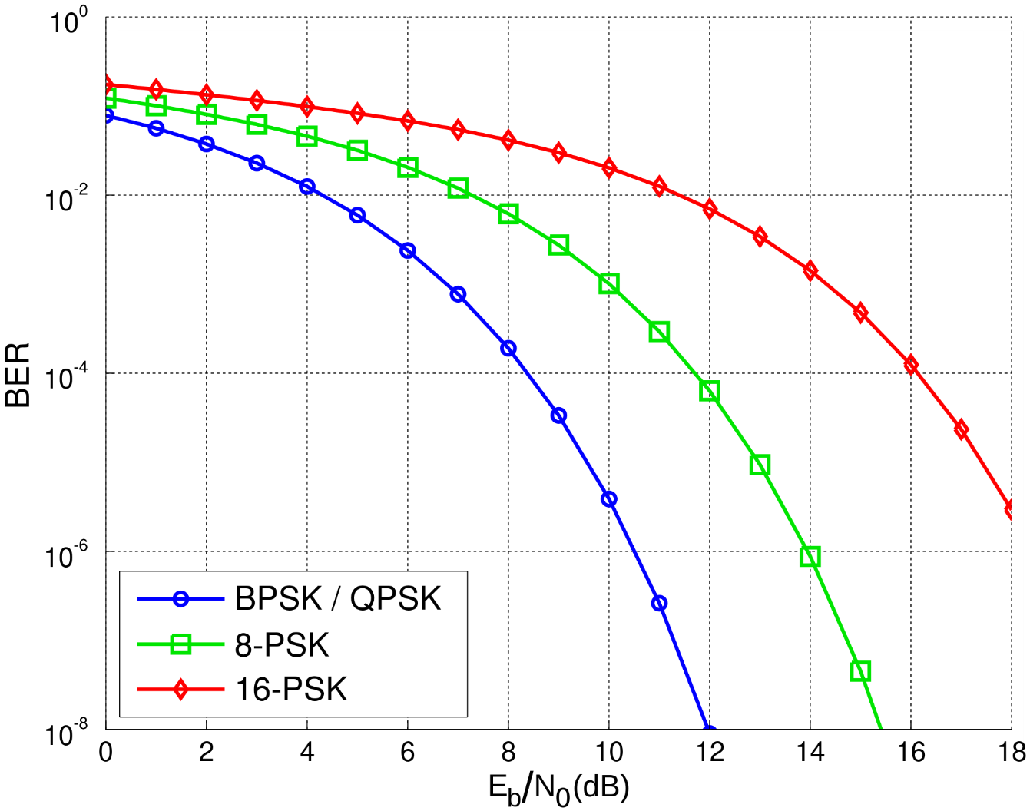
So, who cares?
Noise immunity
Looking at signal-to-noise ratio needed to maintain a low bit error rate.
  Notice BPSK and QPSK are least noise-sensitive.
  And as “M” goes up, we get more noise sensitive.
    Easier to confuse symbols!
https://en.wikipedia.org/wiki/Eb/N0
Notes:
http://www.embedded.com/print/4017668

Slide 44
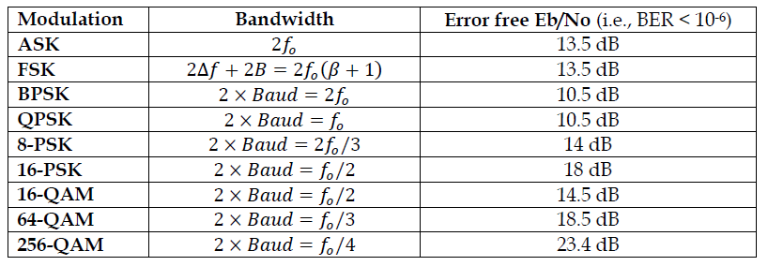
But also need to consider bandwidth requirements
Note: 10dB=10x, 20dB=100x, 30dB=1000x

Slide 45
Modulation
So we have a lot of modulation choices.
  Could view it all as FSK and everything else.

Slide 46
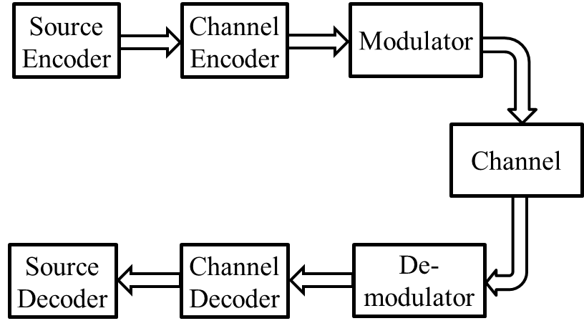
Wireless messages
Sending a message
  We first compress the source (source encoding)
  Then add error correction (channel encoding)
  Then modulate the signal
Each of these steps is fairly complex
  We spent more time on modulation, because our prereq. classes don’t cover it.

Slide 47
Shannon’s limit
First question about the medium:
  How fast can we hope to send data?
Answered by Claude Shannon (given some reasonable assumptions)
  Assuming we have only Gaussian noise, provides a bound on the rate of information that can be reliably moved over a channel.
    That includes error correction and whatever other games you care to play.

Slide 48
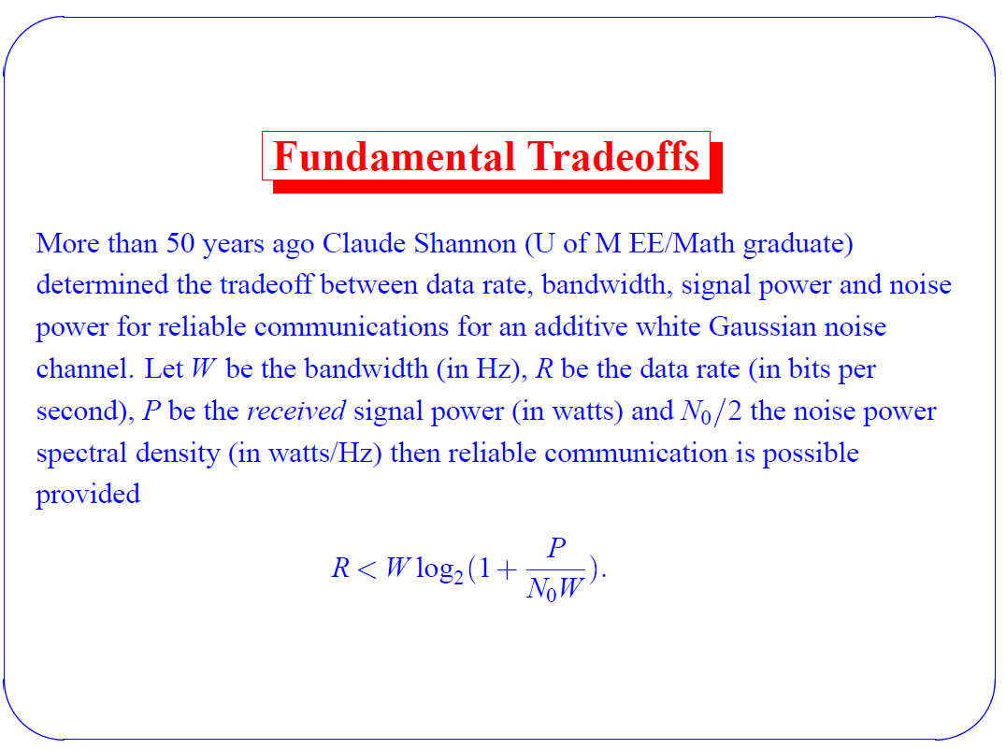
Taken from a slide by Dr. Stark

Slide 49

Shannon–Hartley theorem
We’ll use a different version of this called the Shannon-Hartley theorem.
C is the channel capacity in bits per second;
B is the bandwidth of the channel in hertz
S is the total received signal power measured in Watts or Volts²
N is the total noise, measured in Watts or Volts²
Adapted from Wikipedia.

Slide 50
Comments (1/2)
This is a limit. It says that you can, in theory, communicate that much data with an arbitrarily tight bound on error.
  Not that you won’t get errors at that data rate. Rather that it’s possible you can find an error correction scheme that can fix things up.
    Such schemes may require really really long block sizes and so may be computationally intractable.
There are a number of proofs.
  IEEE reprinted the original paper in 1998
    http://www.stanford.edu/class/ee104/shannonpaper.pdf
  More than we are going to do.
    Let’s just be sure we can A) understand it and B) use it.

Slide 51
Comments (2/2)
What are the assumptions made in the proof?
  All noise is Gaussian in distribution.
    This not only makes the math easier, it means that because the addition of Gaussians is a Gaussian, all noise sources can be modeled as a single source.
    Also note, this includes our inability to distinguish different voltages.
      Effectively quantization noise and also treated as a Gaussian (though it ain’t)
Can people actually do this?
  They can get really close.
    Turbo codes,
    Low density parity check codes.

Slide 52
Examples (1/2)
C is the channel capacity in bits per second;
B is the bandwidth of the channel in Hertz
S is the total received signal power measured in Watts or Volts²
N is the total noise, measured in Watts or Volts²
If the SNR is 20 dB, and the bandwidth available is 4 kHz what is the channel capacity?
  Part 1: convert dB to a ratio (it’s power so it’s base 10)
  Part 2: Plug and chug.
db = 10 log P₁/P₀
P₁=10^{db/10} *P₀
Adapted from Wikipedia.
Notes:
20dB=100. 4*log2(101)=26.63kbits/sec

Slide 53
Examples (2/2)
C is the channel capacity in bits per second;
B is the bandwidth of the channel in Hertz
S is the total received signal power measured in Watts or Volts²
N is the total noise, measured in Watts or Volts²
If you wish to transmit at 50,000 bits/s, and a bandwidth of 1 MHz is available, what S/R ration can you accept?
Adapted from Wikipedia.
Notes:
50k=1MHz*log2(1+N). N=0.035. Or -14.5dB. More noise than power by about a factor of 30!

Slide 54
Summary of Shannon’s limit
Provides an upper-bound on information over a channel
  Makes assumptions about the nature of the noise.
To approach this bound, need to use channel encoding and modulation.
  Some schemes (Turbo codes, Low density parity check codes) can get very close.

Slide 55
Acknowledgments and sources
A 9 hour talk by David Tse has been extremely useful and is a basis for me actually understanding anything (though I’m by no means through it all)
A talk given by Mike Denko, Alex Motalleb, and Tony Qian two years ago for this class proved useful and I took a number of slides from their talk.
An hour long talk with Prabal Dutta formed the basis for the coverage of this talk.
Some other sources:
  http://www.cs.cmu.edu/~prs/wirelessS12/Midterm12-solutions.pdf -- A nice set of questions that get at some useful calculations.
  http://people.seas.harvard.edu/~jones/es151/prop_models/propagation.html all the path loss/propagation models in one place
  http://people.seas.harvard.edu/~jones/cscie129/papers/modulation_1.pdf very nice modulation overview.
I’m grateful for the above sources. All mistakes are my own.

Slide 56
Additional sources/references
General
http://www.cs.cmu.edu/~prs/wirelessS12/Midterm12-solutions.pdf
Modulation
https://fetweb.ju.edu.jo/staff/ee/mhawa/421/Digital%20Modulation.pdf
http://www.ece.umd.edu/class/enee623.S2006/ch2-5_feb06.pdf
https://www.nhk.or.jp/strl/publica/bt/en/le0014.pdf
http://engineering.mq.edu.au/~cl/files_pdf/elec321/lect_mask.pdf (ASK)
http://www.eecs.yorku.ca/course_archive/2010-11/F/3213/CSE3213_07_ShiftKeying_F2010.pdf

Slide 57
Message, Medium, and Power & noise
Message
  Source encoding, Channel encoding, Modulation, and
  Protocol and packets
Medium
  Shannon’s limit, Nyquist sampling, Path loss, Multi-channel, loss models, Slow and fast fading.
Signal power & noise power
  Receive and send power, Antennas, Expected noise floors.
Putting it together
  Modulation (again), MIMO

Slide 58
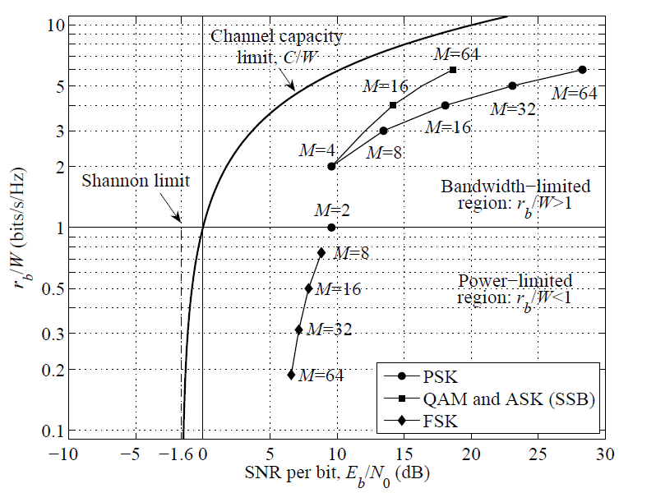
Chart assumes BER of 1E-6 is acceptable.
As implied by use of BER, this assumes no error correction.

