Slide 1
EECS 473 Advanced Embedded Systems
Lecture 15:
Antennas and switching regulators
A number of slides taken from UT-Austin’s EE462L power electronics class.
http://users.ece.utexas.edu/~kwasinski/EE462LS14.html -- very useful!

Slide 2
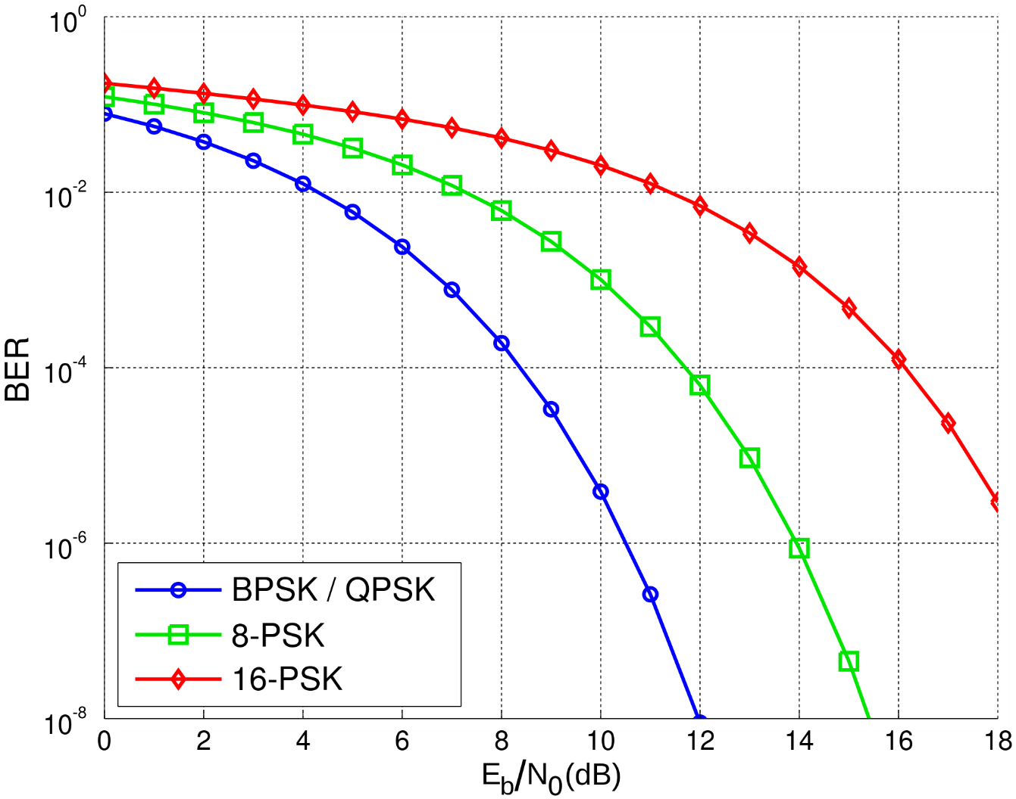
So, who cares? Noise immunity
Looking at signal-to-noise ratio needed to maintain a low bit error rate.
Notice BPSK and QPSK have lower error rates.
And as “M” goes up, we get higher error rates.
Easier to confuse symbols!
https://en.wikipedia.org/wiki/Eb/N0
Notes:
http://www.embedded.com/print/4017668

Slide 3
Project updates
Largest roadblock; Thing you are most pleased with wrt your project.
Robot Arm
FLEX Lift
Key Oracle
Canbats
Transcriber Glasses
Chess
Solar Cell

Slide 4
On to… Antennas and transmission power
Antennas receive power differently depending on where the power is coming from.
An isotropic antenna is one that receives power equally well from all directions.
These don’t exist.
Real antennas focus their “effort” more in some directions than others.
A narrow antenna, like a dish, will be focused in a very narrow range (radiation angle)
Others, like a traditional dipole (the most common antenna) tend to have less narrow of a range.

Slide 5
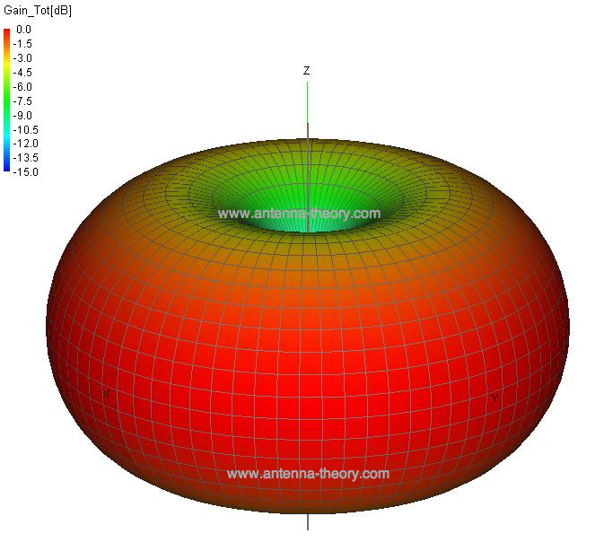
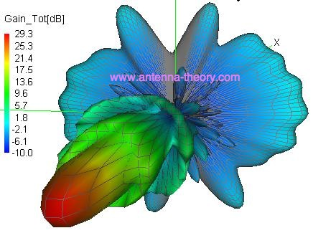
Antennas
Nothing is free here.
If you have a narrow beam, you get some great gain in that beam but get loss in the other directions.
This can be good.
Think about body-area networks or Bluetooth headphones
Toroidal radiation pattern
Dish antenna radiation pattern
Figures from antenna-theory.com (if you couldn’t tell…)

Slide 6
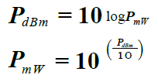
Radio power
Radio signals are generally measured in Watts
However embedded systems generally measure power in mW
Typically 30-100mW for WiFi
It is often easiest to deal with power on a log scale.
So we use “dBm” where
dBm is basically just dB but scaled to mW.
Much of this (including graphics) from https://www.allied-automation.com/wp-content/uploads/2019/03/industrial-wireless-guidebook.pdf

Slide 7
Aside: dB, dBm, dBi
dB itself is a unit-less value
Generally a ratio between two things
On a log scale.
dBm a single value where the “ratio” is to 1mW.
So 20dB means a 100 to 1 ratio
20dBm means 100mW (100 times 1mW)
We’ll also see dBi when looking at antennas.
That’s the power ratio of an antenna to an isotropic antenna (that completely non-directional antenna)
You might see dBd, which is compared to a lossless dipole antenna. It’s 2.15dB lower than dBi.
Vendors generally use dBi (‘cause it’s bigger) and thus so will we.

Slide 8
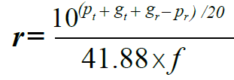
Power received vs. power sent.
The Friis Transmission Formula tells us how much power we’ll receive. It is:
Where:
P_{t} is the radiated power
P_{r} is the received power
G_{t} is the gain of the transmitting antenna
G_{r} is the gain of the receiving antenna
λ is the wavelength
R is the distance between antennas
However, many of those terms aren’t easily available from real spec. sheets.
Instead we do some algebra and unit changes and get the following equation for range in km:
Where f is the frequency in MHz, p_{t} and p_{r} are in dBm and g_{t} and g_{r} are in dBi.

Slide 9
Example
You are running an IEEE 802.11b network and you are currently using wireless devices with the following specifications:
Tx power: 18 dBm @ 11 Mbps
Rx sensitivity: -81dBm @ 11 Mbps
Antenna gain: 2 dBi (both)
802.11b is at 2.4GHz.
Notes:
We are looking at 63mW of broadcast power.
If we had dish antennas pointed at each other with a gain of 25dBi, we’d have (18+50+81)/20=275km!
Note that this assumes an unobstructed line-of-sight signal with no significant interference.
Sometimes realistic, often not.
50kW@720KHz
Notes:
720 KHz
WGN is a clear channel Class A station operating with the maximum AM Radio power of 50,000 watts, using a non-directional antenna. During daytime hours, it can be heard as far as Windsor, Ontario, around 250 miles away, and during the nighttime hours, is often audible over much of the central United States and Canada.
50,000W is 76.9897dBm

Slide 10
Looking at a real antenna (ANT-WSB-ANF-09)
9dBi
Gets there by radiating in a toroid
Spread evenly along the ground (half power beam width is 360°)
Doesn’t go up or down at all.
Half power beam width is at 10°
HPBW: Half power beam width—where you get ½ power.
VSWR (viz-wer): impedance matching stuff, not covered by us.

Slide 11
Switching regulators

Slide 12
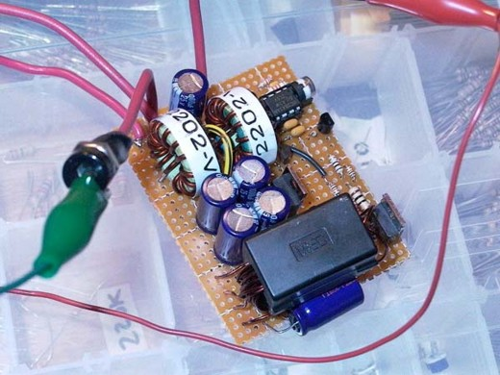
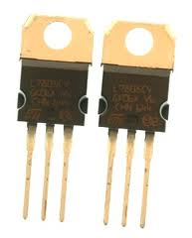
What are DC converters?
DC converters convert one DC voltage level to another.
Very commonly on PCBs
Often have USB or battery power
But might need 1.8V, 3.3V, 5V, 12V and -12V all on the same board.
On-PCB converters allow us to do that
Images from http://itpedia.nyu.edu/wiki/File:V_reg_7805.jpg, http://www.electronics-lab.com/blog/wp-content/uploads/2007/10/p1000255.JPG both now dead links...

Slide 13
Different types of DC converters
Linear converters
Switching converters
Simpler to design
Low-noise output for noise-sensitive applications
Can only drop voltage
And in fact must drop it by some minimum amount
The larger the voltage drop the less power efficient the converter is
Can be significantly more complex to design
Worth avoiding for this class unless you have to do it.
Can drop voltage or increase voltage
“buck” and “boost” respectively
Generally very power efficient
75% to 98% is normal

Slide 14
Characteristics of DC Converters
To better understand how to pick a converter we will go over the following characteristics seen in all DC converters
Power wasted (as heat)
Quiescent current, $I_{Q}$
The leakage current that occurs regardless of operation.
Power supply rejection ratio (PSRR)
The ability to reject output noise at different frequency
External capacitors and equivalent series resistance(ESR)
Output noise filter that helps keeping the signal clean
These characteristics are what people generally look for when selecting converters, but they’re not by any means the only characteristics that matter.

Slide 15
Quick look at the options
Linear converter
LDO
Switching converter
Buck
Boost
Buck-Boost

Slide 16
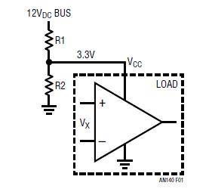
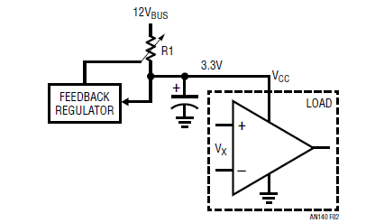
Linear converter
One can think of a linear converter as a “smart” voltage divider.
If we were using a very small amount of current, that would work.
But hugely wasteful.
Instead, we want the top resistor to vary with the load.
As load draws more current, R1 drops resistance to keep voltage constant.
Figures on this slide and the next taken from https://www.analog.com/media/en/technical-documentation/application-notes/an170f.pdf, which is a great app-note.

Slide 17
Voltage converters/regulators: Review Linear
Drops voltage
Heat waste > (Vin-Vout)/Vin
That’s a lot if we are dropping much voltage
Has minimum drop
Uses current even if no load (quiescent current)
Often needs an output (and maybe input) cap.
LDO – low dropout is main variation.
Minimum drop is often very small (though can vary by current draw…)
Generally needs larger caps.
Can have larger quiescent current
Depends on if “resistor” is BJT or FET, FET more common these days.

Slide 18
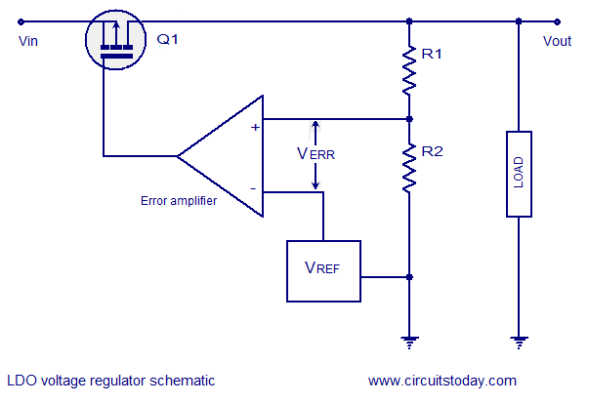
Stability
The opamp adjusts the effective resistance of the transistor to control the voltage.
Clearly we’ve got a control loop and there is delay in that loop.
That means that if the load (or source…) is varying at a certain frequencies, we could get positive feedback.
The output (and sometimes input) cap can filter out those frequencies.
An MOSFET LDO.
http://www.ti.com/lit/an/snva020b/snva020b.pdf provides a very nice, detailed overview with Bode plots etc., though it is a bit dated.

Slide 19
Is stability a real issue for linear regulators?
Well yes.
But these days, the requirements are pretty lax.
The LT3007 wants a 2.2μF ceramic cap at the output and maybe a ~1 μF input cap.
Needs moderately low ESR.
Data sheet expresses concerns about cheap ceramic caps.
Older linear regulators had a lot more restrictions
Often required some additional ESR, but not too much.
Older and cheaper devices might have some pretty significant (and sometimes costly) needs.
Just be aware that in the early 2000s this was a pretty big issue.

Slide 20
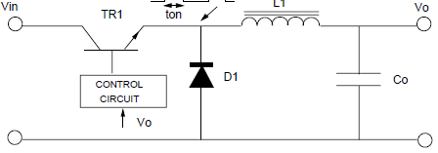
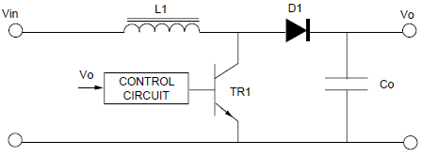
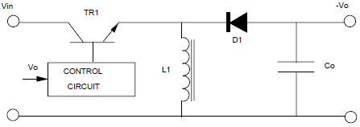
Switching Converters
Once you leave the realms of linear converters it gets more complex.
Introducing common switching converters!
All include a diode, transistor, inductor and a capacitor
Converters | General Topology | Application
Buck |  | Drop voltage
Boost |  | Increase voltage
Buck-boost(inverting) |  | Increase or decrease voltage and inverse polarity
Table from http://www.nxp.com/documents/application_note/APPCHP2.pdf

Slide 21
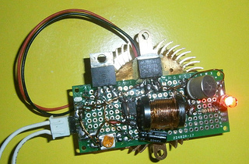
Functionality – Switching Converters
Common switching converters
Converters now include a transistor and diode used for switching and an inductor as energy storage.
In general, a switching converters works by controlling the frequency and duty cycle that the transistor is operating at
Similar to linear converters, most of the work is already done.
Only have to pick IC with the right parameter and follow the datasheets given for appropriate inductors and capacitors.
Size of inductor in relation to the rest of the component
Example switching regulator from http://ycprojects.wordpress.com/

Slide 22
Functionality – Switching Converters
Common switching converters
Aside from the noble goal of making circuit analysis more complex (☺) both the inductor and capacitor play important roles in switching converters.
Capacitor
Used to store energy due to the voltage applied thus maintaining a constant voltage
Generally selected to limit $V_{o}$ ripple to the correct specification
Inductors
Similar to the capacitor, but an inductor is used to store energy due to current flow. This in turn maintains a constant current or is used to limit the rate of change of current flow.
This will also determine the peak to peak current in the circuit which affects the transistor, diode and the “mode” the converter will operate at.

Slide 23
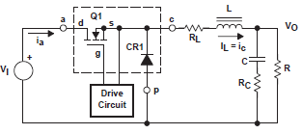
Functionality – Buck
Common switching converters
Let’s start with the buck converter
Note the drive circuit, this is what the IC is
For simplicity’s sake let’s disregard $R_{L}$ and $R_{C}$, the internal resistance of the inductor and capacitor
It looks pretty complex, so let’s try to understand why we need each component!

Slide 24
Capacitors and Inductors
In capacitors:
The voltage cannot change instantaneously
Capacitors tend to keep the voltage constant (voltage “inertia”). An ideal
capacitor with infinite capacitance acts as a constant voltage source.
Thus, a capacitor cannot be connected in parallel with a voltage source
or a switch (otherwise KVL would be violated, i.e. there will be a
short-circuit)
In inductors:
The current cannot change instantaneously
Inductors tend to keep the current constant (current “inertia”). An ideal
inductor with infinite inductance acts as a constant current source.
Thus, an inductor cannot be connected in series with a current source
or a switch (otherwise KCL would be violated)

Slide 25
Switching – lossless conversion of 39V to average 13V
Stereo voltage
Switch closed
Switch open
39
0
+
39Vdc
–
Rstereo
Switch state, Stereo voltage
Closed, 39Vdc
Open, 0Vdc
DT
T
If the duty cycle D of the switch is 0.33, then the average voltage to the expensive car stereo is 39 ● 0.33 = 13Vdc. This is lossless conversion, but will it work?

Slide 26
Convert 39Vdc to 13Vdc, cont.
Try adding a large C in parallel with the load to control ripple. But if the C has 13Vdc, then when the switch closes, the source current spikes to a huge value and burns out the switch.
+
39Vdc
–
C
Rstereo
L
Try adding an L to prevent the huge current spike. But now, if the L has current when the switch attempts to open, the inductor’s current momentum and resulting Ldi/dt burns out the switch.
+
39Vdc
–
C
Rstereo
lossless
L
By adding a “free wheeling” diode, the switch can open and the inductor current can continue to flow. With high-frequency switching, the load voltage ripple can be reduced to a small value.
+
39Vdc
–
C
Rstereo
A DC-DC Buck Converter

Slide 27
Functionality – Buck
Common switching converters - buck
During operation, the buck converter functions differently depending on the switch
On state
Current flows through the transistor but reverse bias prevents current flow through the diode
Inductor begins to charge and a smaller current becomes $I_{load}$
Off state
Switch opens and the inductor starts discharging as the only power source
This on-off state will determine the “mode” the converter operate in
Buck: switch on
Buck: switch off
Figures from Wikipedia

Slide 28
Functionality – Switching Converters
The duty cycle of the switching will determine the mode each converter operate at various loads
Continuous Mode
The inductor current will never fall to zero when the switch is off
Discontinuous Mode
Inductor current will reach zero before the end of the full duty cycle
Each mode has its advantages and disadvantages depending on the switching converters.
In generally it’s how they change the frequency response.

Slide 29
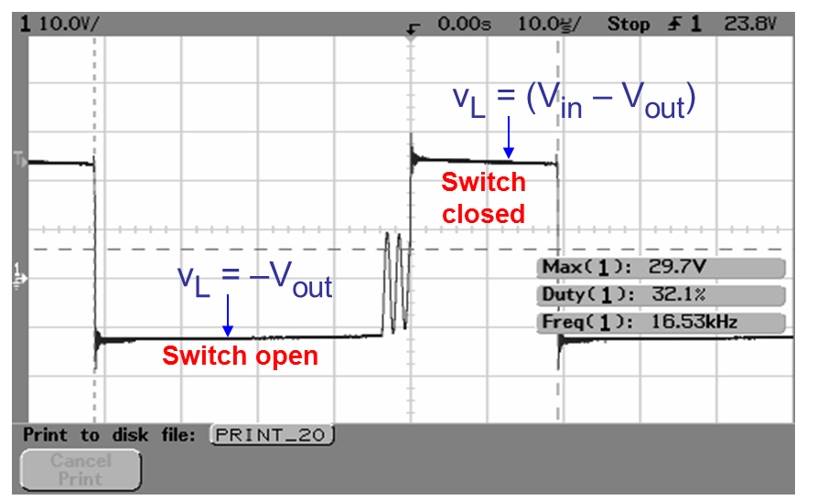
Net effect—avoiding discontinuous mode
Lower load current, lower inductance and lower switching frequency move us toward discontinuous mode.
There are pros and cons
to both modes, but one
real issue is that switching
between them can cause ringing on the inductor’s output.
(See UT slides for why, has to do with parasitic
cap in transistor and diode.)

Slide 30
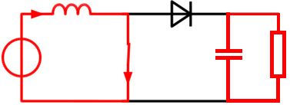
Functionality – Boost (Doing this much more quickly)
On state
Current flows through the transistor(least resistance) making the diode reverse bias and no $I_{D}$
Inductor is charged in the process
Off state
The energy discharged by the inductor is superimposed to the input, generating a higher output
Generic boost schematic
Boost: on state
Schematics from http://en.wikipedia.org/wiki/Boost_converter
Boost: off state

Slide 31
+ v
L
–
i
i
L
I
out
Buck converter
in
L
+
V
in
C
V
out
i
C
–
+ v
L
–
i
L
I
out
Boost converter
i
in
L
+
V
in
C
V
out
i
C
–

Slide 32
!
Boost converter
+ v
L
–
i
L
i
D
I
out
i
in
L
+
V
in
C
V
out
i
C
–
This is a much more unforgiving circuit than the buck converter
If the MOSFET gate driver sticks in the “on” position, then there is a short circuit through the MOSFET – blow MOSFET!
If the load is disconnected during operation, so that I_{out} = 0, then L continues to push power to the right and very quickly charges C up to a high value (≈250V) – blow diode and MOSFET!
Before applying power be sure that a load is solidly connected

Slide 33
Functionality – Switching Converters
Common switching converters
Buck-boost(inverting)
The baby of buck and boost…
On state
Diode is reverse biased and the inductor is charged but input and output is isolated from each other
Creates more stress on the diode!
$V_{o}$ is now the charged $V_{c}$ from off state but different polarity
Off state
Inductor voltage reverses, passing energy to the capacitor and load through forward biased diode
Due to the characteristics of boost, buck-boost suffers the same problem. Therefore a discontinuous mode is favored
Generic buck- boost schematic
Buck-boost: on state
Buck-boost: off state
Schematics from http://en.wikipedia.org/wiki/Buck%E2%80%93boost_converter

Slide 34
Functionality – Switching Converters
To give you a better idea of how duty cycle affect the output of each converter in continuous mode refer to the table below
In discontinuous mode these equations are no longer true, but we will not discuss them here and they can also be found online
More information on switching converters can be found at http://educypedia.karadimov.info/library/APPCHP2.pdf https://web.archive.org/web/20120306171808/http://ecee.colorado.edu/copec/book/slides/Ch5slide.pdf http://www.ti.com/lit/an/slva057/slva057.pdf
Converters | Duty cycle impact on output Voltage
Buck | Vout=Vin*D
Boost | Vout=$\frac{Vin}{1−D}$
Buck-boost(inverting) | Vout=$\frac{Vin∗D}{D−1}$

Slide 35
Picking converters
Hopefully at this point you can start to see how much more complicated a switching converter is relative to a linear converter
Every change made to the capacitor, inductor, transistor or diode will have an significant effect in not only the efficiency of each converter but also the life and way they operate
Fortunately it won’t be the end of the world if you decide to use switching converters
Using mic2168a, a controller for buck converter, as example. We can see not only do they provide information on the controller but also the external components needed for proper functionality (9pages!).
ON semiconductor also provide a detailed, though dated, published paper on both linear and switching regulator, covering the theory and design consideration needed.

Slide 36
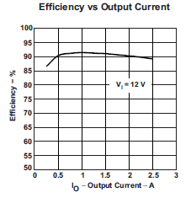
Efficiency of switchers
It’s going to vary a lot.
Depends on the converter, the output current, etc.
Graph on the right is of a TPS5420 under reasonable conditions.
Typically has only 18μA current when you shut it down (needs a control pin)
TPS5420

